Slide 1
POS Tagging

Slide 2
Parts of speech
Parts of speech are constructed by grouping words that function
similarly:
with respect to the words that can occur nearby
and by their morphological properties
The man all the way home.
Aristotle (384–322 BCE): the idea of having parts of speech
a.k.a lexical categories, word classes, “tags”, POS
Dionysius Thrax of Alexandria (c. 100 BCE) : 8 parts of speech
noun, verb, article, adverb, preposition, conjunction, participle, pronoun

Slide 3
English parts of speech
8 parts of speech?
Noun (person, place or thing)
Verb (actions and processes)
Adjective (modify nouns)
Adverb (modify verbs)
Preposition (on, in, by, to, with)
Determiners (a, an, the, what, which, that)
Conjunctions (and, but, or)
– Particle (off, up)
Brown corpus: 87 POS tags
Penn Treebank: ~45 POS tags

Slide 4
Open vs. Closed classes
Open vs. Closed classes
Closed:
determiners: a, an, the
pronouns: she, he, I
prepositions: on, under, over, near, by, …
Why “closed”?
Open:
Nouns, Verbs, Adjectives, Adverbs.

Slide 5
Closed vs. Open Class
Closed class categories are composed of a small, fixed set of grammatical function words for a given language.
Pronouns, Prepositions, Modals, Determiners, Particles,
Conjunctions
Open class categories have large number of words and new ones are easily invented.
Nouns (Googler, textlish), Verbs (Google), Adjectives (geeky), Abverb (chompingly)
5

Slide 6
Open class (lexical) words
Nouns Verbs
Adjectives
old older oldest
sundara, acchaa,
Common
cat / cats
Snow
Kitaaba , kalama,
Proper
IBM
Italy
Mohan
Main
see
registered
Adverbs
slowly
jaldii, teza
giraa, gayaa
Numbers
… more
122,312
one
Closed class (functional)
Modals
Determiners the some
can had
Prepositions to with
Conjunctions
and or
Particles
to, bhii, hii
off up
… more
aur, agar
Pronouns
he its
Interjections
Ow Eh
Vaha, main

Slide 7
Part Of Speech Tagging
Annotate each word in a sentence with a part-of- speech marker.
John Saw the saw and decided to take it to the table.
NNP VBD DT NN CC VBD TO VB PRP IN DT NN
8

Slide 8
UDEP POS tags
Open class words | Closed class words | Other
ADJ | ADP | PUNCT
ADV | AUX | SYM
INTJ | CCONJ | X
NOUN | DET
PROPN | NUM
VERB | PART
PRON
SCONJ

Slide 9
Ambiguity in POS Tagging
“Like” can be a verb or a preposition
I like/VBP candy.
Time flies like/IN an arrow.
“Around” can be a preposition, particle, or adverb
I bought it at the shop around/IN the corner.
I never got around/RP to getting a car.
A new Prius costs around/RB $25K.
What is the POS for “back”?
The back door
On my back
Win the voters back
Promised to back the bill
10

Slide 10
POS Tagging task
Input: the lead paint is unsafe
Output: the/Det lead/N paint/N is/V unsafe/Adj
• Uses:
text-to-speech (how do we pronounce “lead”?)
can differentiate word senses that involve part of speech differences (what is the meaning of “interest”)
can write regexps like Det Adj* N* over the output (for filtering collocations)
preprocessing for parser
11

Slide 11
Ambiguity in POS tagging
Like most language components, the challenge with POS tagging is ambiguity
Brown corpus analysis
11.5% of word types are ambiguous (this sounds promising!), but…
40% of word appearances are ambiguous
Unfortunately, the ambiguous words tend to be the more frequently used words

Slide 12
Constituency
Parts of speech can be thought of as the lowest level of syntactic information
Groups words together into categories
likes to eat candy.
What can/can’t go here?

Slide 13
Constituency
likes to eat candy.
determiner nouns
The man The boy The cat
nouns Dinesh Dr Roy
Professor Das
pronouns
He She
determiner nouns +
The man that I saw
The boy with the blue pants The cat in the hat

Slide 14
Constituency
Words in languages tend to form into functional groups (parts of speech)
Groups of words (aka phrases) can also be grouped into functional groups
often some relation to parts of speech
though, more complex interactions
These phrase groups are called constituents

Slide 15
POS Tagging Approaches
Rule-Based: Human crafted rules based on lexical and other linguistic knowledge.
Learning-Based: Trained on human annotated corpora like the Penn Treebank.
Statistical models: Hidden Markov Model (HMM), Maximum Entropy Markov Model (MEMM), Conditional Random Field (CRF)
Rule learning: Transformation Based Learning (TBL)
Neural networks: Recurrent networks like Long Short
Term Memory (LSTMs), Transformers !
17

Slide 16
Sequence Modelling HMM

Slide 17
Sequence Labeling Problem
Many NLP problems can viewed as sequence labeling.
Each token in a sequence is assigned a label.
Labels of tokens are dependent on the labels of other tokens in the sequence, particularly their neighbors (not i.i.d).

Slide 18
Information Extraction
Identify phrases in language that refer to specific types of
entities and relations in text.
Named entity recognition is task of identifying names of people, places, organizations, etc. in text.
people organizations places
Michael Dell is the CEO of Dell Computer Corporation and lives in Austin Texas.
Extract pieces of information relevant to a specific
application, e.g. used car ads:
make model year mileage price
For sale, 2002 Toyota Prius, 20,000 mi, $15K or best offer.

Slide 19
Semantic Role Labeling
For each clause, determine the semantic role played by each noun phrase that is an argument to the verb.
agent patient source destination instrument
John drove Mary from Austin to Dallas in his Toyota Prius.
The hammer broke the window.
Also referred to a “case role analysis,” “thematic analysis,” and “shallow semantic parsing”

Slide 20
Bioinformatics
Sequence labeling also valuable in labeling genetic sequences in genome analysis.
extron intron
– AGCTAACGTTCGATACGGATTACAGCCT

Slide 21
Problems with Sequence Labeling as Classification
Need to integrate information from category of tokens on both sides.
Difficult to propagate uncertainty between decisions and “collectively” determine the most likely joint assignment of categories to all of the tokens in a sequence.

Slide 22
Probabilistic Sequence Models
Probabilistic sequence models allow integrating uncertainty over multiple, interdependent classifications and collectively determine the most likely global assignment.
Two standard models
Hidden Markov Model (HMM)
Conditional Random Field (CRF)

Slide 23
Markov Model / Markov Chain
A finite state machine with probabilistic state transitions.
Markov assumption: the next state only depends on the current state and independent of previous history.
The set of all states: {s}
Initial states: S_{I}
Final states: S_{F}
Probability of making the transition from state i to j: a_{ij}

Slide 24
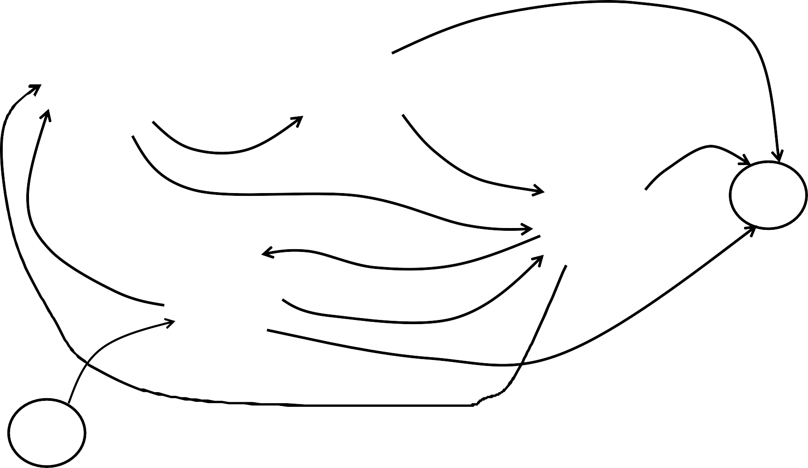
Sample Markov Model for POS
0.1
Det
Noun
0.95
0.5
0.9
stop
0.05
Verb
0.25
0.1
0.4
PropNoun
0.8
0.5
0.1
0.25
0.1
start

Slide 25
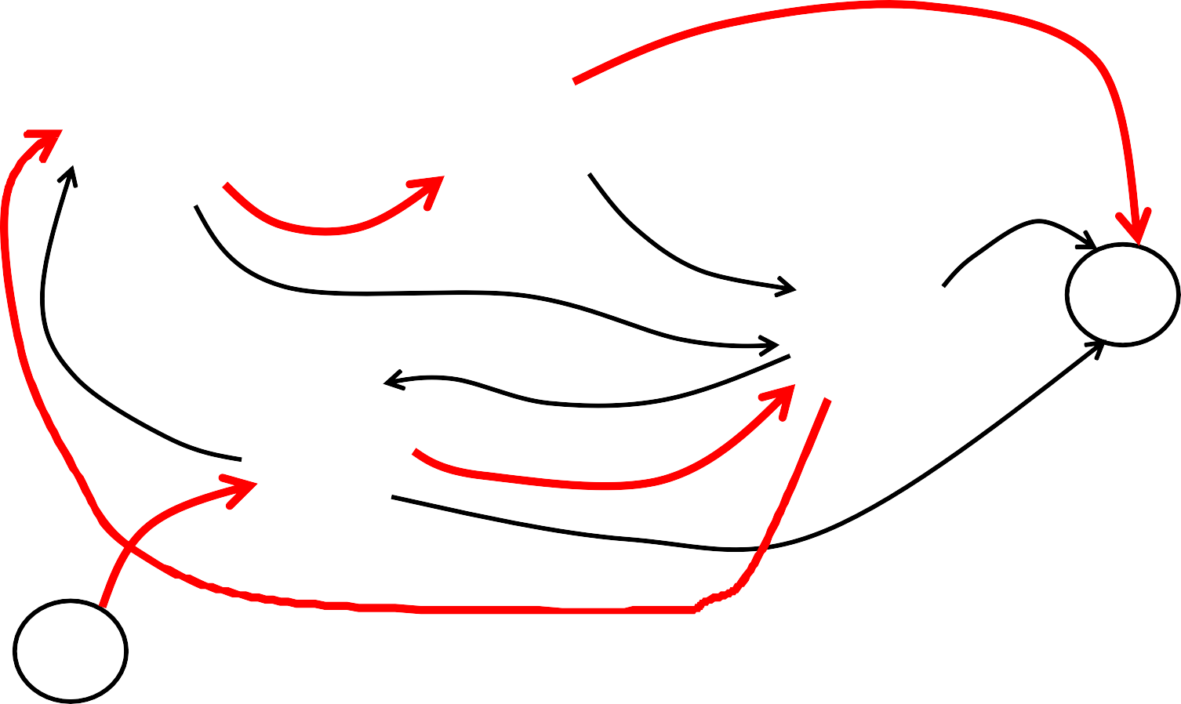
Sample Markov Model for POS
0.1
Det
Noun
0.95
0.5
0.9
stop
0.05
Verb
0.25
0.8
0.1
0.4
PropNoun
0.5
0.1
0.25
0.1
start
P(PropNoun Verb Det Noun) = 0.4∗0.8∗0.25∗0.95∗0.1=0.0076

Slide 26
Hidden Markov Model
Probabilistic generative model for sequences.
Assume
An underlying set of hidden states in which the model can be (e.g. parts of speech).
Probabilistic transitions between states over time
A probabilistic generation of tokens from states (e.g. words generated for each POS).
A set of output symbols
Probability of emitting the symbol k in state j: b_{j}(k)

Slide 27
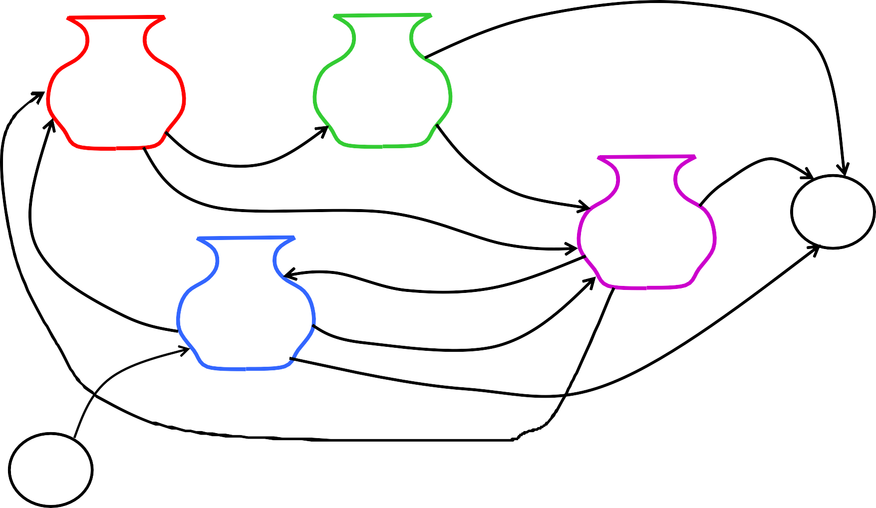
Sample HMM for POS
the
cat
0.1
a _{a} the
dog _{bed}
the a the that
Det
car
pen
apple
0.95
0.5
Noun
0.9
bit
_{ate} saw
stop
0.05
played
hit gave
Verb
Tom
0.25
0.1
0.4
John_{Mary}
Alice
0.8
Jerry
0.5
PropNoun
0.1
0.25
0.1
start

Slide 28
Definition of an HMM
A set of N +2 states S={s₀,s₁,s₂, … s_{N,} s_{F}}
A set of M possible observations V={v₁,v₂…v_{M}}
A state transition probability distribution A={a_{ij}}
a_{ij} = P(q_{t+1} = s | j | | q_{t} = s_{i} ) | 1≤ i, j ≤ N and i = 0, j = F
N ∑a_{ij} + a_{iF} = 1 j=1 | 0 ≤ i ≤ N
Observation probability distribution for each state j B={b_{j}(k)}
b_{j} (k) = P(v_{k} at t | q_{t} = s_{j} ) 1≤ j ≤ N 1≤ k ≤ M
Total parameter set λ={A,B}

Slide 29
HMM Generation Procedure
To generate a sequence of T observations:
O = o₁ o₂ … o_{T}
Set initial state q₁=s₀
For t = 1 to T
Transit to another state q_{t+1}=s_{j} based on transition distribution a_{ij} for state q_{t}
Pick an observation o_{t}=v_{k} based on being in state q_{t} using distribution b_{qt}(k)

Slide 30
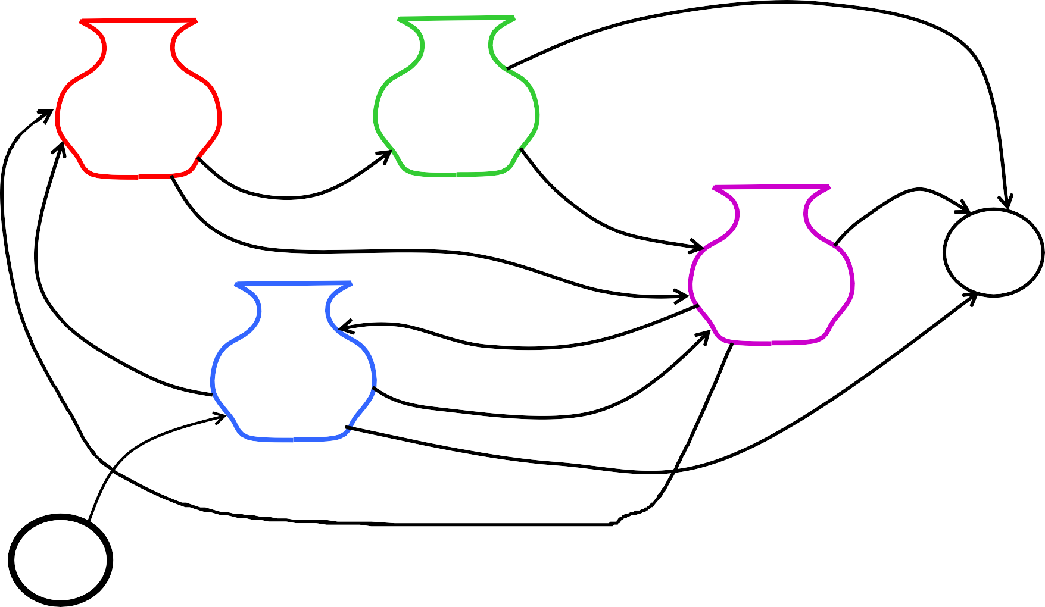
Sample HMM Generation
the
cat
0.1
a _{a} the
dog _{bed}
the a the that
Det
car
pen
apple
0.95
0.5
Noun
0.9
bit
_{ate} saw
stop
0.05
played
hit gave
Verb
Tom
0.25
0.1
0.4
John_{Mary}
Alice
0.8
Jerry
0.5
PropNoun
0.1
0.25
0.1
start

Slide 31
Three Useful HMM Tasks
Observation Likelihood (Evaluation): given a model and an output sequence, what is the probability that the model generated that output?
Most likely state sequence (Decoding): given a model and an output sequence, what is the most likely state sequence through the model that generated the output?
Maximum likelihood training (Learning): given a model and a set of observed sequences, how do we set the model’s parameters so that it has a high probability of generating those sequences?

Slide 32
HMM: Observation Likelihood
Given a sequence of observations, O, and a model with parameters, λ, what is the probability that this observation was generated by this model:
P(O| λ) ?
Useful for two tasks:
Sequence Classification
Most Likely Sequence

Slide 33
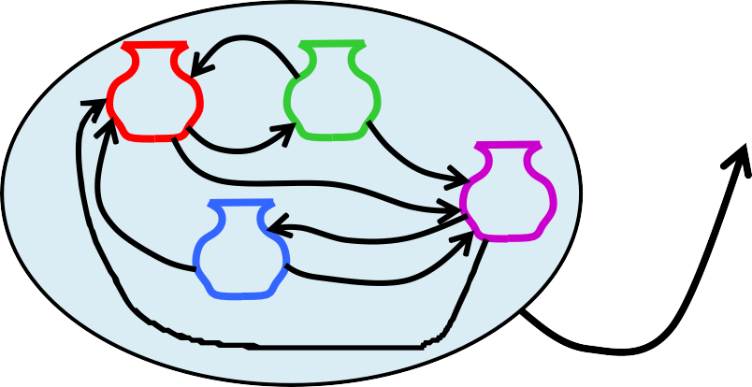
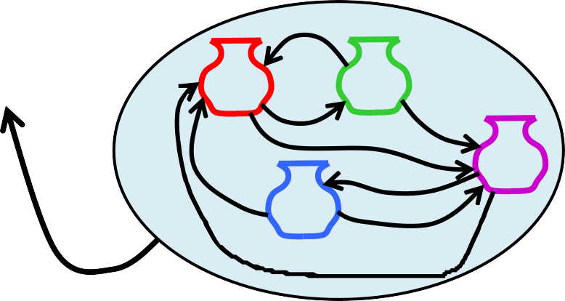
Sequence Classification
Assume an HMM is available for each category (i.e. language).
What is the most likely category for a given observation sequence,
i.e. which category’s HMM is most likely to have generated it?
Used in speech recognition to find most likely word model to have
generate a given sound or phoneme sequence.
O ah s t e n
?
?
Austin
Boston
P(O | Austin) > P(O | Boston) ?

Slide 34
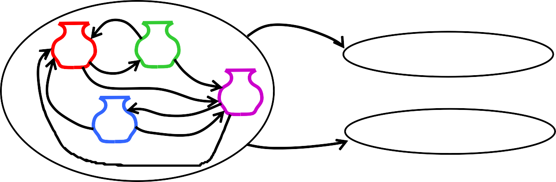
Most Likely Sequence
Of two or more possible sequences, which one was most likely generated by a given model?
Used to score alternative word sequence interpretations in speech recognition.
O₁
?
dice precedent core
?
vice president Gore
O₂
Ordinary English
P(O₂ | OrdEnglish) > P(O₁ | OrdEnglish) ?

Slide 35
HMM: Observation Likelihood Efficient Solution
Forward Algorithm: Compute a forward trellis that compactly and implicitly encodes information about all possible state paths.

Slide 36
Forward Trellis
Continue forward in time until reaching final time point and sum probability of ending in final state.

Slide 37
Forward Probabilities
Let α_{t}(j) be the probability of being in state j after seeing the first t observations (by summing over all initial paths leading to j).
α_{t} ( j) = P(o₁,o₂ ,...o_{t} , q_{t} = s_{j} | λ)

Slide 38


Forward Step
Consider all possible ways of getting to s_{j} at time t by coming from all
s
possible states s_{i} and determine
1
ª1j ª2j ª2j
s₂
•
•
•
probability of each.
Sum these to get the total probability of being in state s_{j} at time t while accounting for the first t −1 observations.
Then multiply by the probability of actually observing o_{t} in s_{j.}
s_{j}
ªNj
s
N
α_{t-1}(i)
α_{t}(i)

Slide 39
Computing the Forward Probabilities
Initialization
α₁( j) = a_{0 j}b_{j} (o₁) 1≤ j ≤ N
Recursion
⎡
N
α ( j) =
∑ t −1 ij ⎥ j t
⎢
α (i)a ⎤b (o )
1 ≤ j ≤ N, 1 < t ≤ T
t
⎣ i=1
⎦
Termination
P(O | λ) = α_{T +1} (s_{F} ) = ∑α_{T} (i)a_{iF}
i=1
N

Slide 40
α_{t} ( j) = P(o₁,o₂ ,...o_{t} , q_{t} = s_{j} | λ)
α₁( j) = a_{0 j}b_{j} (o₁) 1≤ j ≤ N
⎡
N
α ( j) =
∑ t −1 ij ⎥ j t
⎢
α (i)a ⎤b (o )
1 ≤ j ≤ N, 1 < t ≤ T
t
⎣ i=1
⎦
P(O | λ) = α_{T +1} (s_{F} ) = ∑α_{T} (i)a_{iF}
i=1
N

Slide 41
Forward Computational Complexity
Requires only O(TN²) time to compute the probability of an observed sequence given a model.

Slide 42
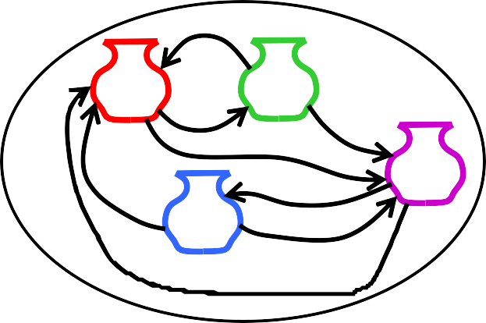
2. Most Likely State Sequence (Decoding)
Given an observation sequence, O, and a model, λ, what is the most likely state sequence, Q=q₁,q₂,…q_{T}, that generated this sequence from this model?
John gave the dog an apple.

Slide 43
Most Likely State Sequence
Given an observation sequence, O, and a model, λ, what is the most likely state sequence,Q=q₁,q₂,…q_{T}, that generated this sequence from this model?
John gave the dog an apple.
Det Noun PropNoun Verb

Slide 44
Most Likely State Sequence
Given an observation sequence, O, and a model, λ, what is the most likely state sequence,Q=q₁,q₂,…q_{T}, that generated this sequence from this model?
John gave the dog an apple.
Det Noun PropNoun Verb

Slide 45

Most Likely State Sequence
Given an observation sequence, O, and a model, λ, what is the most likely state sequence,Q=q₁,q₂,…q_{T}, that generated this sequence from this model?
John gave the dog an apple.
Det Noun PropNoun Verb

Slide 46

Most Likely State Sequence
Given an observation sequence, O, and a model, λ, what is the most likely state sequence,Q=q₁,q₂,…q_{T}, that generated this sequence from this model?
John gave the dog an apple.
Det Noun PropNoun Verb

Slide 47
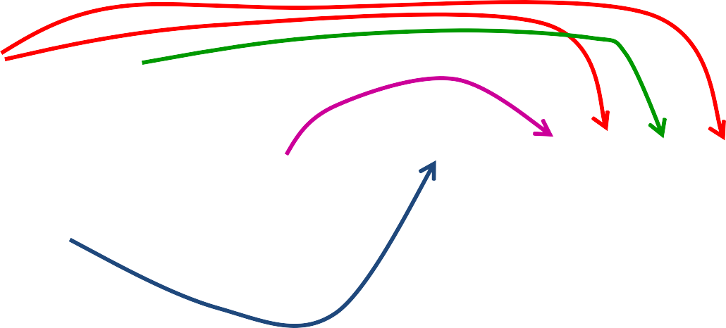

Most Likely State Sequence
Given an observation sequence, O, and a model, λ, what is the most likely state sequence,Q=q₁,q₂,…q_{T}, that generated this sequence from this model?
John gave the dog an apple.
Det Noun PropNoun Verb

Slide 48
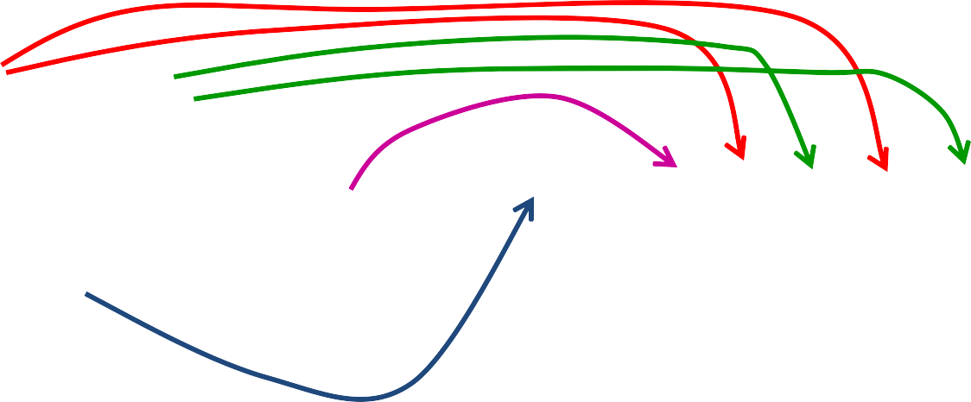

Most Likely State Sequence
Given an observation sequence, O, and a model, λ, what is the most likely state sequence,Q=q₁,q₂,…q_{T}, that generated this sequence from this model?
John gave the dog an apple.
Det Noun PropNoun Verb

Slide 49
Viterbi Scores
Recursively compute the probability of the most likely subsequence of states that accounts for the first t observations and ends in state s_{j}.
v_{t} ( j) = max P(q₀ , q₁,...,q_{t −1}, o₁,...,o_{t} , q_{t} = s _{j} | λ )
q₀ ,q₁ ,...,q_{t−1}
Also record “backpointers” that subsequently allow
backtracing the most probable state sequence.
bt_{t}(j) stores the state at time 𝑡 − 1 that maximizes the probability that system was in state s_{j} at time t (given the observed sequence).

Slide 50
Computing the Viterbi Scores
v_{t} ( j) = max P(q₀ , q₁,...,q_{t −1}, o₁,...,o_{t} , q_{t} = s _{j} | λ)
q₀ ,q₁ ,...,q_{t−1}
Initialization
Recursion
v₁( j) = a_{0 j}b_{j} (o₁) 1≤ j ≤ N
N
v_{t} ( j) = max v_{t −1} (i)a_{ij} b_{j} (o_{t} )
1 ≤ j ≤ N, 1 < t ≤ T
i=1
Termination
N
P* = v_{T +1} (s_{F} ) = max v_{T} (i)a_{iF}
i=1
Analogous to Forward algorithm except take max instead of sum

Slide 51
Computing the Viterbi Backpointers
Initialization
Recursion
bt₁( j) = s₀ 1≤ j ≤ N
N
bt_{t} ( j) = argmaxv_{t −1} (i)a_{ij} b_{j} (o_{t} )
i=1
1 ≤ j ≤ N , 1 ≤ t ≤ T
Termination
N
q_{T} * = bt_{T +1} (s_{F} ) = argmax v_{T} (i)a_{iF}
i=1
Final state in the most probable state sequence. Follow backpointers to initial state to construct full sequence.

Slide 52
Viterbi Backpointers
N
v_{t} ( j) = max v_{t −1} (i)a_{ij} b_{j} (o_{t} )
1 ≤ j ≤ N, 1 < t ≤ T
i=1
N
bt_{t} ( j) = argmaxv_{t −1} (i)a_{ij} b_{j} (o_{t} )
i=1
1 ≤ j ≤ N , 1 ≤ t ≤ T

Slide 53
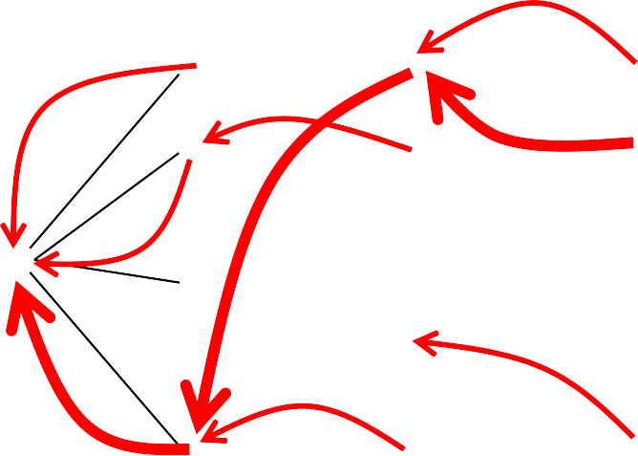





Viterbi Backtrace
s₁ s₂
• • •
• • •
• • •
•
•
•
•
•
•
•
•
•
•
•
•
•
•
•
s
s
0
F
s_{N}
• • •
t₁ t₂ t₃
^{t}T-1
t_{T}
Most likely Sequence: s₀ s_{N} s₁ s₂ …s₂ s_{F}

Slide 54
HMM Learning
Supervised Learning: All training sequences are completely labeled (tagged).
Unsupervised Learning: All training sequences are unlabelled (but generally know the number of tags,
i.e. states).
Semisupervised Learning: Some training sequences are labeled, most are unlabeled.

Slide 55
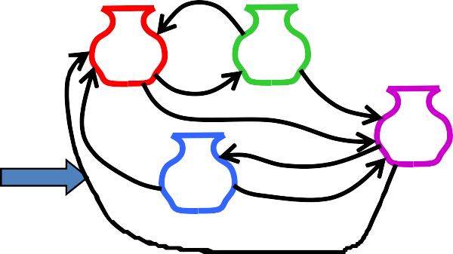
Supervised HMM Training
If training sequences are labeled (tagged) with the underlying state sequences that generated them, then the parameters, λ={A,B} can all be estimated directly.
Training Sequences
John ate the apple A dog bit Mary Mary hit the dog
John gave Mary the cat.
.
.
.
Supervised HMM
Training
Det Noun PropNoun Verb

Slide 56
Supervised Parameter Estimation
Estimate state transition probabilities based on tag bigram and unigram statistics in the labeled data.
₌ C(q_{t} = s_{i} , q_{t+1} = s _{j} )
a
ij
C(q_{t} = s_{i} )
Estimate the observation probabilities based on tag/word co-occurrence statistics in the labeled data.
C(q_{i} = s _{j} , o_{i} = v_{k} )
b (k) =
j
C(q_{i} = s _{j} )
Use appropriate smoothing if training data is sparse.

Slide 57
Learning and Using HMM Taggers
Use a corpus of labeled sequence data to construct an HMM using supervised training.
Given a novel unlabeled test sequence to tag, use the Viterbi algorithm to predict the most likely (globally optimal) tag sequence.

Slide 58
Evaluating Taggers
Train on training set of labeled sequences.
Possibly tune parameters based on performance on a development set.
Measure accuracy on a disjoint test set.
Generally measure tagging accuracy, i.e. the percentage of tokens tagged correctly.
Accuracy of most modern POS taggers, including HMMs is 96−97% (for Penn tagset trained on about 800K words) .
– Generally matching human agreement level.

Slide 59
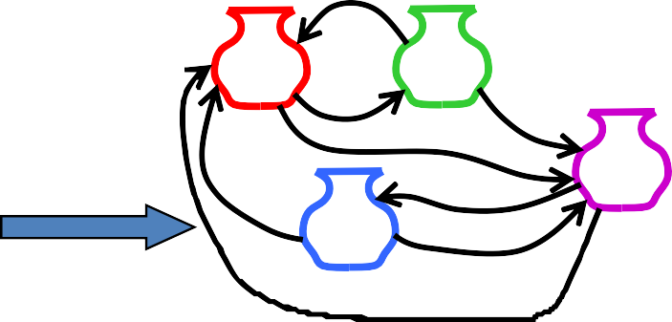
Unsupervised Maximum Likelihood Training
Training Sequences
ah s t e n a s t i n oh s t u n eh z t en
.
.
.
HMM
Training
Austin

Slide 60
Maximum Likelihood Training
Given an observation sequence, O,
what set of parameters, λ, for a given model maximizes the probability that this data was generated from this model (P(O| λ))?
Used to train an HMM model and properly induce its parameters from a set of training data.

Slide 61
Bayes Theorem
_{P(H | E) =} P(E | H )P(H )
P(E)
Simple proof from definition of conditional probability:
P(H | E) = ^{P(H ∧ E)}
(Def. cond. prob.)
P(E)
P(H ∧ E)
P(E | H ) =
(Def. cond. prob.)
P(H )
P(H ∧ E) = P(E | H )P(H )
_{QED: P(H | E) =} P(E | H )P(H )
P(E)

Slide 62
Maximum Likelihood vs.
Maximum A Posteriori (MAP)
The MAP parameter estimate is the most likely given the observed data, O.
λ = argmaxP(λ | O) = argmax ^{P(O | λ)P(λ)}
MAP
P(O)
λ λ
argmax P(O | λ)P(λ)
λ
If all parameterizations are assumed to be equally likely a
priori, then MLE and MAP are the same.
If parameters are given priors (e.g. Gaussian or Laplacian with zero mean), then MAP is a principled way to perform smoothing or regularization.

Slide 63
HMM: Maximum Likelihood Training
Efficient Solution
There is no known efficient algorithm for finding the
parameters, λ, that truly maximizes P(O| λ).
However, using iterative re-estimation, the Baum-Welch algorithm (a.k.a. forward-backward) , a version of a standard statistical procedure called Expectation Maximization (EM), is able to locally maximize P(O| λ).
In practice, EM is able to find a good set of parameters that
provide a good fit to the training data in many cases.

Slide 64
EM Algorithm
Iterative method for learning probabilistic categorization model from unsupervised data.
Initially assume random assignment of examples to categories.
Learn an initial probabilistic model by estimating model parameters θ from this randomly labeled data.
Iterate following two steps until convergence:
Expectation (E-step): Compute P(c_{i} | E) for each example given the current model, and probabilistically re-label the examples based on these posterior probability estimates.
Maximization (M-step): Re-estimate the model
parameters, θ, from the probabilistically re-labeled data.

Slide 65




EM
Initialize:
Assign random probabilistic labels to unlabeled data
Unlabeled Examples
+
−
+
−
+
−
+
−
+
−

Slide 66




EM
Initialize:
Give soft-labeled training data to a probabilistic learner
+
−
+
−
Prob. Learner
+
−
+
−
+
−

Slide 67



EM
Initialize:
Produce a probabilistic classifier
+
−
+
−
Prob. Learner
Prob. Classifier
+
−
+
−
+
−

Slide 68








EM
E Step:
Relabel unlabeled data using the trained classifier
+
−
Prob.
Learner
Prob. Classifier
+
−
+
−
+
−
+
−
M step:
Retrain classifier on relabeled data
+
−
Prob. Learner
Prob. Classifier
+
−
+
−
+
−
+
−
Continue EM iterations until probabilistic labels on unlabeled data converge.

Slide 69
Sketch of Baum-Welch (EM) Algorithm for Training HMMs
Assume an HMM with N states.
Randomly set its parameters λ=(A,B)
(making sure they represent legal distributions) Until converge (i.e. λ no longer changes) do:
E Step: Use the forward/backward procedure to determine the probability of various possible state sequences for generating the training data
M Step: Use these probability estimates to
re-estimate values for all of the parameters λ

Slide 70
EM Properties
Each iteration changes the parameters in a way that is guaranteed to increase the likelihood of the data: P(O|λ).
Anytime algorithm: Can stop at any time prior to convergence to get approximate solution.
Converges to a local maximum.

Slide 71
Semi-Supervised Learning
EM algorithms can be trained with a mix of labeled and unlabeled data.
EM basically predicts a probabilistic (soft) labeling of the instances and then iteratively retrains using supervised learning on these predicted labels (“self training”).
EM can also exploit supervised data:
1) Use supervised learning on labeled data to initialize the parameters (instead of initializing them randomly).
2) Use known labels for supervised data instead of predicting soft labels for these examples during retraining iterations.

Slide 72









Semi-Supervised EM
Training Examples
Unlabeled Examples
+
+
−
-
Prob. Learner
Prob. Classifier
+
−
-
+
−
+
+
−
+
+
−

Slide 73




Semi-Supervised EM
Training Examples
+
+
−
-
Prob. Learner
Prob. Classifier
+
−
-
+
−
+
+
−
+
+
−

Slide 74






Semi-Supervised EM
Training Examples
+
-
Prob. Learner
Prob. Classifier
-
+
+
+
−
+
−
+
−
+
−
+
−

Slide 75





Semi-Supervised EM
Training Examples
Unlabeled Examples
+
+
−
-
Prob. Learner
Prob. Classifier
+
−
-
+
−
+
+
−
+
+
−

Slide 76

Semi-Supervised EM
Training Examples
+
+
−
-
Prob. Learner
Prob. Classifier
+
−
-
+
−
+
+
−
+
+
−
Continue retraining iterations until probabilistic labels on unlabeled data converge.

Slide 77
Semi-Supervised Results
Use of additional unlabeled data improves on supervised learning when amount of labeled data is very small and amount of unlabeled data is large.
Can degrade performance when there is sufficient labeled data to learn a decent model and when unsupervised learning tends to create labels that are incompatible with the desired ones.
– There are negative results for semi-supervised POS tagging since unsupervised learning tends to learn semantic labels (e.g. eating verbs, animate nouns) that are better at predicting the data than purely syntactic labels (e.g. verb, noun).

Slide 78
POS Tagging is the lowest level of syntactic analysis.
It is an instance of sequence labeling, that also has applications in information extraction, phrase chunking, semantic role labeling, and bioinformatics.
HMMs are a standard generative probabilistic model for sequence labeling that allows for efficiently computing the globally most probable sequence of labels and supports supervised, unsupervised and semi-supervised learning.

Slide 79
Conditional Random Field CRF

Slide 80
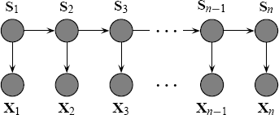
Hidden Markov Model
n
p(s, x) = p(s₁ ) p(x₁ | s₁ )∏ p(s_{i} | s_{i−1} ) p(x_{i} | s_{i} )
i=2
Cannot represent multiple interacting features or long range
dependences between observed elements.
2

Slide 81
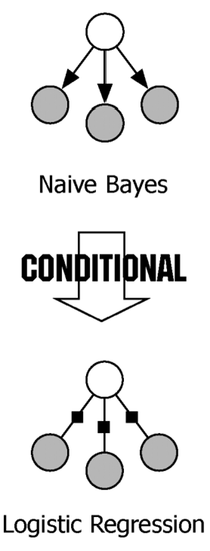


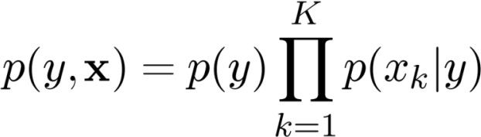
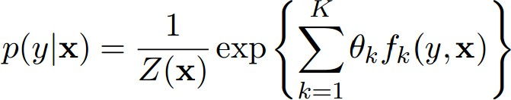
Discriminative Vs. Generative
Generative Model: A model that generate observed data randomly
Naïve Bayes: once the class label is known, all the features are independent
p(y, x)
Discriminative: Directly estimate the posterior probability; Aim at modeling the “discrimination” between different outputs
MaxEnt classifier: linear combination of feature function in the exponent,
p(y | x)
Both generative models and discriminative models describe distributions over (y , x), but they work in different directions.

Slide 82
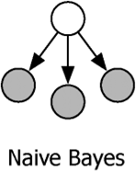
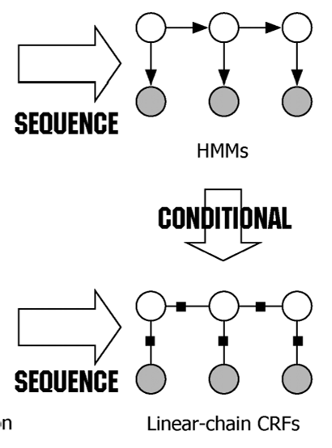
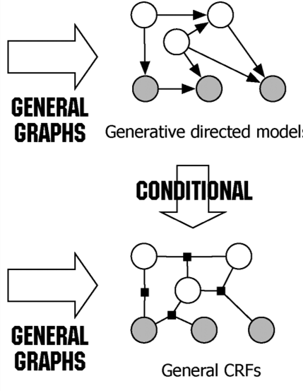
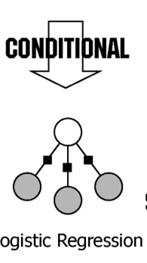


Discriminative Vs. Generative
p(y, x)
p(y | x)
=observable
=unobservable

Slide 83
Graphical Models
If no assumption of independence is made, then an exponential number of parameters must be estimated for sound probabilistic inference.
If a blanket assumption of conditional independence is made, efficient training and inference is possible, but such a strong assumption is rarely warranted.
Graphical models use directed or undirected graphs over a set of random variables to explicitly specify variable dependencies and allow for less restrictive independence assumptions while limiting the number of parameters that must be estimated.
Bayesian Networks: Directed acyclic graphs that indicate causal structure
Markov Networks: Undirected graphs that capture general dependencies

Slide 84
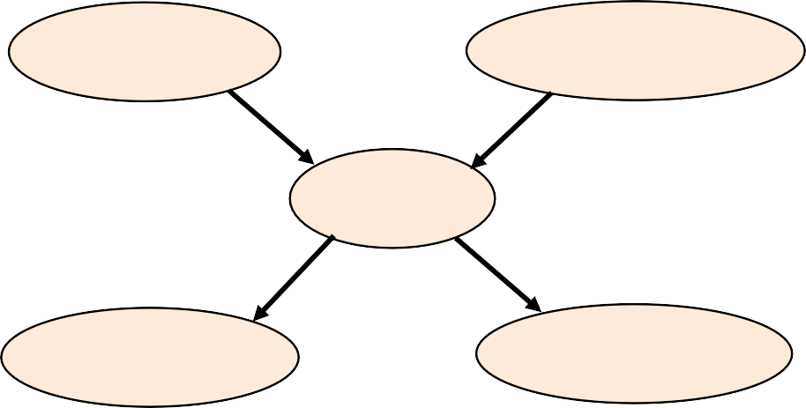
Bayesian Networks
Directed Acyclic Graph (DAG)
Nodes are random variables
Edges indicate causal influences
Burglary
Earthquake
Alarm
JohnCalls
MaryCalls

Slide 85
Conditional Probability Tables
Each node has a conditional probability table (CPT) that gives the probability of each of its values given every possible combination of values for its parents (conditioning case).
– Roots (sources) of the DAG that have no parents are given prior probabilities.
P(B)
.001
P(E)
.002
Burglary
Earthquake
B | E | P(A)
T | T | .95
T | F | .94
F | T | .29
F | F | .001
Alarm
A | P(J)
T | .90
F | .05
A | P(M)
T | .70
F | .01
JohnCalls
MaryCalls

Slide 86
Joint Distributions for Bayes Nets
A Bayesian Network implicitly defines a joint distribution.
P(x₁, x₂ ,...x_{n} ) = ∏P(x_{i} | Parents( X_{i} ))
n
i=1
Example
P(J ∧ M ∧ A ∧ ¬B ∧ ¬E)
= P(J | A)P(M | A)P( A | ¬B ∧ ¬E)P(¬B)P(¬E)
= 0.9×0.7×0.001×0.999×0.998 = 0.00062

Slide 87
Naïve Bayes as a Bayes Net
Naïve Bayes is a simple Bayes Net
Y
…
X₁ X₂
X_{n}
Priors P(Y) and conditionals P(X_{i}|Y) for Naïve Bayes provide CPTs for the network.

Slide 88
Markov Networks
Undirected graph over a set of random variables, where an edge represents a dependency.
The Markov blanket of a node, X, in a Markov Net is the set of its neighbors in the graph (nodes that have an edge connecting to X).
Every node in a Markov Net is conditionally independent of every other node given its Markov blanket.

Slide 89
Distribution for a Markov Network
The distribution of a Markov net is mostcompactly described in terms of a set of potential functions (a.k.a. factors, compatibility functions), 𝜓_{𝑘}, for each clique, k, in the graph.
For each joint assignment of values to the variables in clique k, 𝜓_{𝑘} assigns a non-negative real value that represents the compatibility of these values.

Slide 90
Sample Markov Network
E | A | φ₂
T | T | 50
T | F | 10
F | T | 1
F | F | 200
B | A | φ₁
T | T | 100
T | F | 1
F | T | 1
F | F | 200
Burglary
Earthquake
Alarm
JohnCalls
MaryCalls
M | A | φ₄
T | T | 50
T | F | 1
F | T | 10
F | F | 200
J | A | φ₃
T | T | 75
T | F | 10
F | T | 1
F | F | 200

Slide 91




Sequence prediction
NER: identifying and classifying proper names in text,
Set of observation,
Set of underlying sequence of states,
HMM is generative:
Observation probability
Doesn’t model long-range dependencies
Not practical to represent multiple interacting features (hard to model p(x))
The primary advantage of CRFs over hidden Markov models is their conditional nature, resulting in the relaxation of the independence assumptions
And it can handle overlapping features

Slide 92
..
Sequence Labeling
Y
Y
Y
1
2
T
HMM
…
X₁
X₂
X_{T}
Generative
Conditional
Discriminative
..
Y
Y
Y
1
2
T
Linear-chain CRF
…
X₁
X₂
X_{T}

Slide 93
Simple Linear Chain CRF Features
Modeling the conditional distribution is similar to that used in multinomial logistic regression.
Create feature functions f_{k}(Y_{t}, Y_{t−1}, X_{t})
Feature for each state transition pair i, j
f_{i,j}(Y_{t}, Y_{t−1}, X_{t}) = 1 if Y_{t} = i and Y_{t−1} = j and 0 otherwise
Feature for each state observation pair i, o
f_{i,o}(Y_{t}, Y_{t−1}, X_{t}) = 1 if Y_{t} = i and X_{t} = o and 0 otherwise
Note: number of features grows quadratically in the number of states (i.e. tags).
15

Slide 94
Conditional Distribution for Linear Chain CRF
Using these feature functions for a simple linear chain CRF, we can define:
16

Slide 95
Adding Token Features to a CRF
Can add token features X_{i,j}
…
Y₁
Y₂
Y_{T}
…
…
…
…
^{X}1,1
^{X}1,m
^{X}2,1
^{X}2,m
^{X}T,1
^{X}T,m
Can add additional feature functions for each token feature to model conditional distribution.
17

Slide 96
Features in POS Tagging
For POS Tagging, use lexicographic features of tokens.
Capitalized?
Start with numeral?
Ends in given suffix (e.g. “s”, “ed”, “ly”)?
18

Slide 97
Enhanced Linear Chain CRF (standard approach)
Can also condition transition on the current token features.
…
Y₁ Y₂ Y_{T}
…
^{X}1,1
^{X}2,1
^{X}T,1
…
…
…
^{X}1,m
^{X}2,m
^{X}T,m
Add feature functions:
f_{i,j,k}(Y_{t}, Y_{t−1}, X) 1 if Y_{t} = i and Y_{t−1} = j and X_{t −1,k} = 1
and 0 otherwise
19

Slide 98
Supervised Learning (Parameter Estimation)
As in logistic regression, use L-BFGS optimization procedure, to set λ weights to maximize CLL of the supervised training data.
See paper for details.
20

Slide 99
Sequence Tagging (Inference)
Variant of Viterbi algorithm can be used to efficiently, O(TN²), determine the globally most probable label sequence for a given token sequence using a given log-linear model of the conditional probability P(Y | X).
See paper for details.
21

Slide 100
Skip-Chain CRFs
Can model some long-distance dependencies (i.e. the same word appearing in different parts of the text) by including long-distance edges in the Markov model.
Y₁
Y₂
Y₃
^{Y}100
^{Y}101
…
X₁
Michael
X₂ X₃
Dell said
^{X}100
Dell
^{X}101
bought
Additional links make exact inference intractable, so must resort to approximate inference to try to
find the most probable labeling.
22

Slide 101
CRF Results
Experimental results verify that they have superior accuracy on various sequence labeling tasks.
Part of Speech tagging
Noun phrase chunking
Named entity recognition
Semantic role labeling
However, CRFs are much slower to train and do not scale as well to large amounts of training data.
Training for POS on full Penn Treebank (~1M words) currently takes “over a week.”
Skip-chain CRFs improve results on IE.
23

Slide 102
CRF Summary
CRFs are a discriminative approach to sequence labeling whereas HMMs are generative.
Discriminative methods are usually more accurate since they are trained for a specific performance task.
CRFs also easily allow adding additional token features without making additional independence assumptions.
Training time is increased since a complex optimization procedure is needed to fit supervised training data.
24

Slide 103
State of the art - POS
Penn Treebank
A standard dataset for POS tagging is the Wall Street Journal (WSJ) portion of the Penn Treebank, containing 45 different POS tags.
24

Slide 104
State of the art - POS
Model | Accuracy | Paper / Source | Code
Meta BiLSTM (Bohnet et al., 2018) | 97.96 | Morphosyntactic Tagging with a Meta-BiLSTM Model over Context Sensitive Token Encodings | Official
Flair embeddings (Akbik et al., 2018) | 97.85 | Contextual String Embeddings for Sequence Labeling | Flair framework
Char Bi-LSTM (Ling et al., 2015) | 97.78 | Finding Function in Form: Compositional Character Models for Open Vocabulary Word Representation
Adversarial Bi-LSTM (Yasunaga et al., 2018) | 97.59 | Robust Multilingual Part-of-Speech Tagging via Adversarial Training
BiLSTM-CRF + IntNet (Xin et al., 2018) | 97.58 | Learning Better Internal Structure of Words for Sequence Labeling
Yang et al. (2017) | 97.55 | Transfer Learning for Sequence Tagging with Hierarchical Recurrent Networks
Ma and Hovy (2016) | 97.55 | End-to-end Sequence Labeling via Bi-directional LSTM-CNNs-CRF
LM-LSTM-CRF (Liu et al., 2018) | 97.53 | Empowering Character-aware Sequence Labeling with Task-Aware Neural Language Model
NCRF++ (Yang and Zhang, 2018) | 97.49 | NCRF++: An Open-source Neural Sequence Labeling Toolkit | NCRF++
Feed Forward (Vaswani et a. 2016) | 97.4 | Supertagging with LSTMs
Bi-LSTM (Ling et al., 2017) | 97.36 | Finding Function in Form: Compositional Character Models for Open Vocabulary Word Representation
Bi-LSTM (Plank et al., 2016) | 97.22 | Multilingual Part-of-Speech Tagging with Bidirectional Long Short-Term Memory Models and Auxiliary Loss
24

Slide 105
State of the art - POS
Morphosyntactic Tagging with a Meta-BiLSTM Model over Context Sensitive Token Encodings
24

Slide 106
State of the art - POS
NCRF++: An Open-source Neural Sequence Labeling Toolkit
24

Slide 107
CRF Features - POS
def word2features(sent, i): word = sent[i][0] features = { 'bias': 1.0, 'word': word, 'len(word)': len(word), 'word[:4]': word[:4], 'word[:3]': word[:3], 'word[:2]': word[:2], 'word[-3:]': word[-3:], 'word[-2:]': word[-2:], 'word[-4:]': word[-4:], 'word.lower()': word.lower(), 'word.stemmed': re.sub(r'(.{2,}?)([aeiougyn]+$)',r'\1', word.lower()), 'word.ispunctuation': (word in string.punctuation),
24

Slide 108
CRF Features - POS
'word.isdigit()': word.isdigit(), } if i > 0: word1 = sent[i-1][0] features.update({ '-1:word': word1, '-1:len(word)': len(word1), '-1:word.lower()': word1.lower(), '-1:word.stemmed': re.sub(r'(.{2,}?)([aeiougyn]+$)',r'\1', word1.lower()), '-1:word[:3]': word1[:3], '-1:word[:2]': word1[:2], '-1:word[-3:]': word1[-3:], '-1:word[-2:]': word1[-2:], '-1:word.isdigit()': word1.isdigit(), '-1:word.ispunctuation': (word1 in string.punctuation), }) else: features['BOS'] = True
24

Slide 109
CRF Features - POS
if i > 1: word2 = sent[i-2][0] features.update({ '-2:word': word2, '-2:len(word)': len(word2), '-2:word.lower()': word2.lower(), '-2:word[:3]': word2[:3], '-2:word[:2]': word2[:2], '-2:word[-3:]': word2[-3:], '-2:word[-2:]': word2[-2:], '-2:word.isdigit()': word2.isdigit(), '-2:word.ispunctuation': (word2 in string.punctuation), }) if i < len(sent)-1: word1 = sent[i+1][0] features.update({ '+1:word': word1,
24

Slide 110
CRF Features - POS
'+1:len(word)': len(word1), '+1:word.lower()': word1.lower(), '+1:word[:3]': word1[:3], '+1:word[:2]': word1[:2], '+1:word[-3:]': word1[-3:], '+1:word[-2:]': word1[-2:], '+1:word.isdigit()': word1.isdigit(), '+1:word.ispunctuation': (word1 in string.punctuation), }) else: features['EOS'] = True if i < len(sent) - 2: word2 = sent[i+2][0] features.update({ '+2:word': word2, '+2:len(word)': len(word2), '+2:word.lower()': word2.lower(),
24

Slide 111
CRF Features - POS
'+2:word.stemmed': re.sub(r'(.{2,}?)([aeiougyn]+$)',r'\1', word2.lower()), '+2:word[:3]': word2[:3], '+2:word[:2]': word2[:2], '+2:word[-3:]': word2[-3:], '+2:word[-2:]': word2[-2:], '+2:word.isdigit()': word2.isdigit(), '+2:word.ispunctuation': (word2 in string.punctuation), }) return features
24

